Slide 1
Control Flow – Decision Statements
COS 1020 C++ Programming
AUBG COS Department
Based on chapter 4 – problem solving, abstraction and design using C++, Friedman & Koffman

Slide 2
Lecture Contents
4.1 Control Structures
4.2 Logical Expressions
4.3 Introduction to the if Control Statement
4.4 if Statements with Compound Alternatives
4.7 Nested if Statements and Multiple-Alternative Decisions
4.8 The switch Control Statement

Slide 3
Control Structures
Regulate the flow of execution in a program:
  Sequence
  Selection (decisions)
  Repetition (loops)
Compound Statement
  A group of statements enclosed by { and } braces and executed sequentially
  Sequential control means that each statement is executed in sequence, one after another without skipping any lines

Slide 4
Control Structures (continued)
Compound Statement
    {
    statement1;
    statement2;
    …
    statementN;
    }
Selection Control
  Enables the program to execute one of several alternative statements or group of statements

Slide 5
Logical Expressions
In C++ the primary selection control structure is the if statement:
if (weight > 100) {
shipCost = 10.00;
}
else {
shipCost = 5.00;
}

Slide 6
Logical Expressions (continued)
Logical expressions (conditions) are used to perform tests for selecting among alternative statements to execute.
Evaluate to either true or false
Typical forms:
  variable relational-operator variable
  variable relational-operator constant
  variable equality-operator variable
  variable equality-operator constant

Slide 7
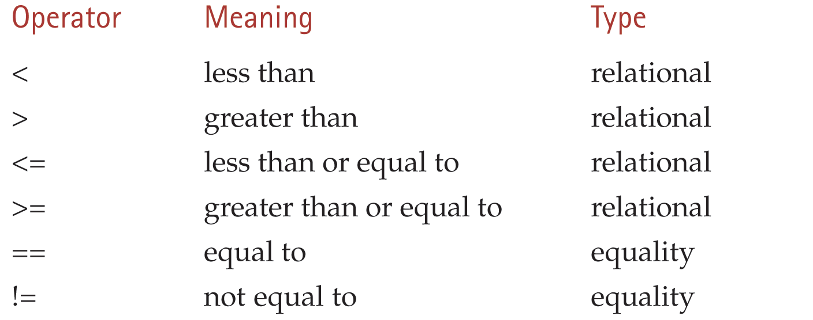
Relational and Equality Operators
NOTE: Be careful not to confuse the assignment operator (single =) with the
equality operator (double ==)!

Slide 8
Relational and Logical Operators Example
Assume:
int x = -5, y = 7,
power = 1024, maxPower = 1024;
char gender = 'm';
x <= 0
power < maxPower
x >= y
gender == 'm'

Slide 9
Logical Operators
Logical expressions can also contain logical operators:
  && (and)
  || (or)
  ! (not)
Used to form more complex conditions, for example:
    (salary < minSalary) || (dependents > 5)
    (temp > 90.0) && (humidity > 0.90)
    winningRecord && (!probation)

Slide 10
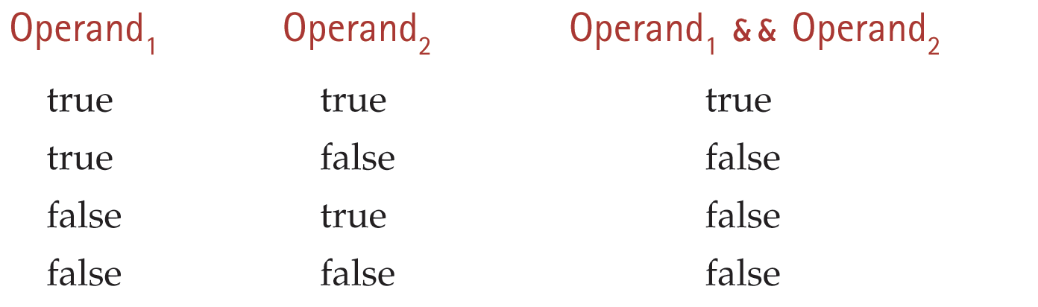
The && Operator
Yields a true result only if both operands are true. Otherwise it is false

Slide 11
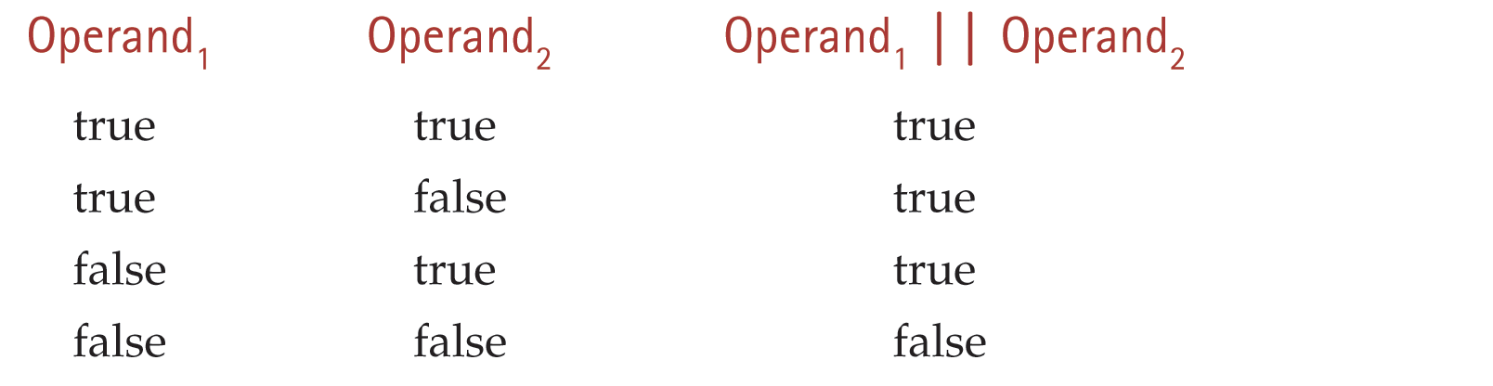
The || Operator
Yields a true result if either or both of its operands are true. Otherwise it is false

Slide 12
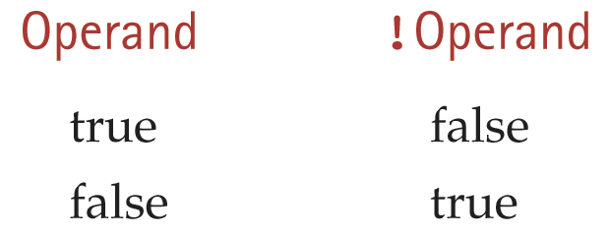
The ! Operator
Yields the logical complement (negation) of its operand

Slide 13
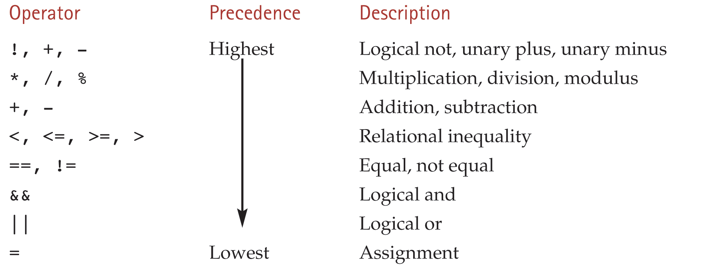
Operator Precedence

Slide 14
Operator Precedence Example
x = 3.0
y = 4.0
z = 2.0
flag = false
! flag || (y + z >= x - z)
true
6.0
1.0
true
true

Slide 15
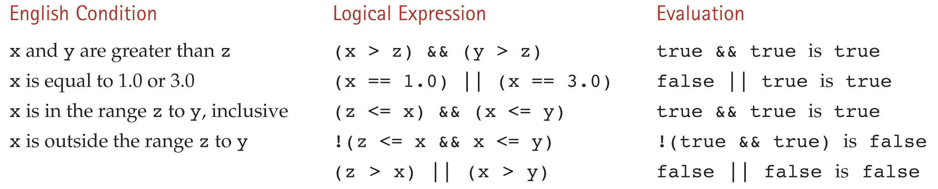
English Conditions as C++ Expressions

Slide 16
Comparing Characters and Strings
In addition to numbers, you can also compare characters and strings using the relational and equality operators.
Letters are in alphabetical order
Upper and lower case letters are different (upper are first)
Digit characters are also ordered as expected ('0', '1', etc)
Comparing string objects requires the string library
  Compares corresponding pairs of characters in each string, starting with the first

Slide 17
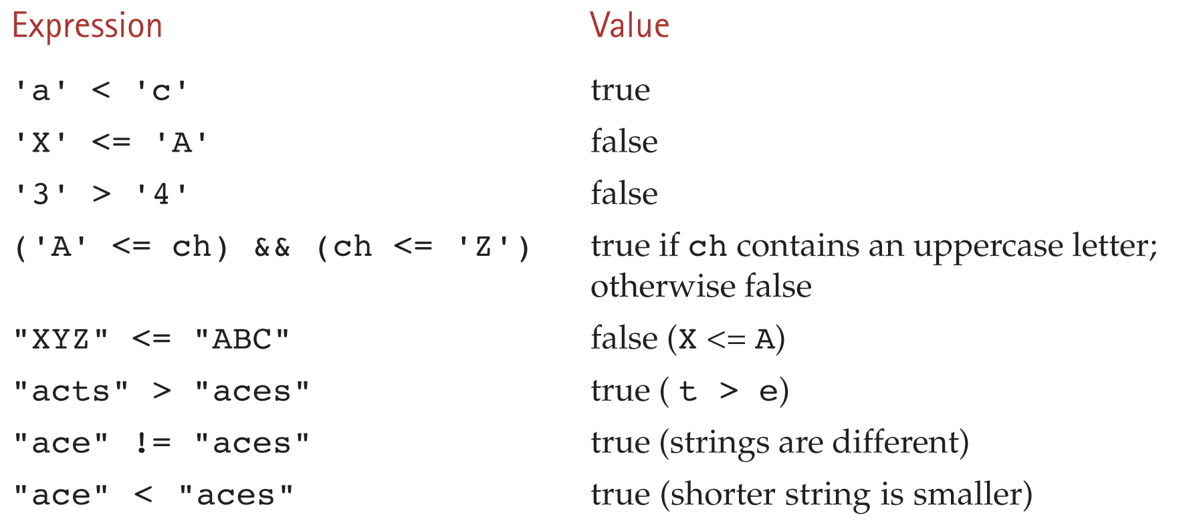
Example of Comparisons

Slide 18
Boolean Assignment
Recall that the assignment statements have the general form:
  variable = expression;
We can assign bool values to variables of type bool:
valid = true;
valid = (x >= 0) && (x <= 10);
isUpper = (('A' <= ch) && (ch <= 'Z'));
even = (n % 2) == 0;

Slide 19
Writing bool Values
Boolean values are represented by integer values in C++
  0 for false
  Any non-zero (typically 1) for true
When outputting bool variables we will get 0 for false and 1 for true values
To read data into a bool variable, we can use 0 for false and 1 for true

Slide 20
The if Control Statement
Allows a condition to be specified in the program, e.g. "is b an even number"
That condition is evaluated and based on the result, different course of action is selected
Two basic forms:
  A choice between two alternatives
  A dependent (conditional) statement

Slide 21
if Statement with Two Alternatives
General form:
  if (condition)
  statementT;
  else
  statementF;
Example:
if (gross > 100)
net = gross - tax;
else
net = gross;

Slide 22
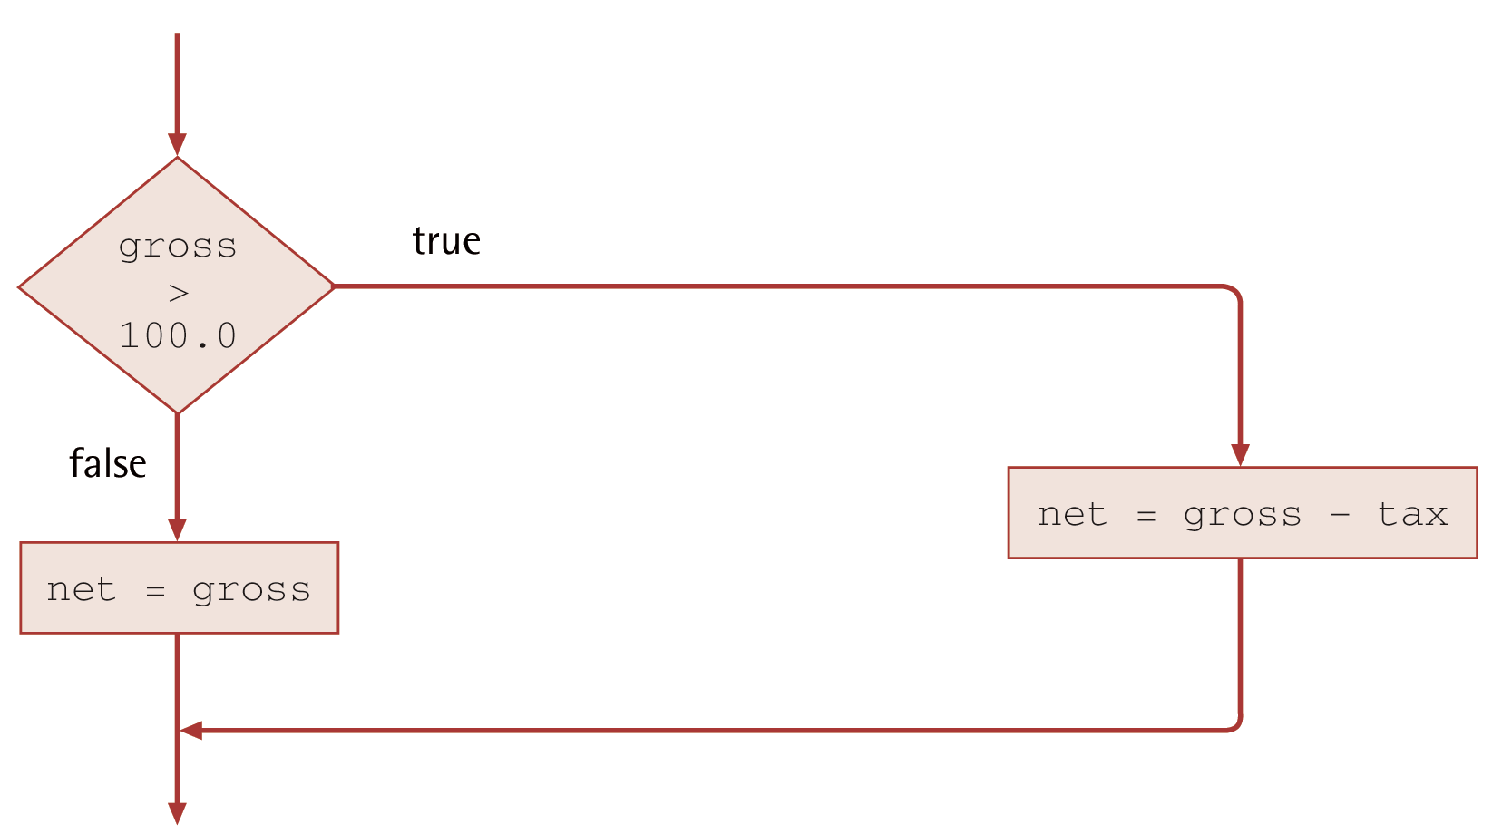
Flowchart of if Statement with Two Alternatives

Slide 23
if Statement with Dependent Statement
When the condition evaluates to true, the statement is executed. If false, it is skipped
General form:
  if (condition)
  statementT;
Example:
if (x != 0)
product = product * x;

Slide 24
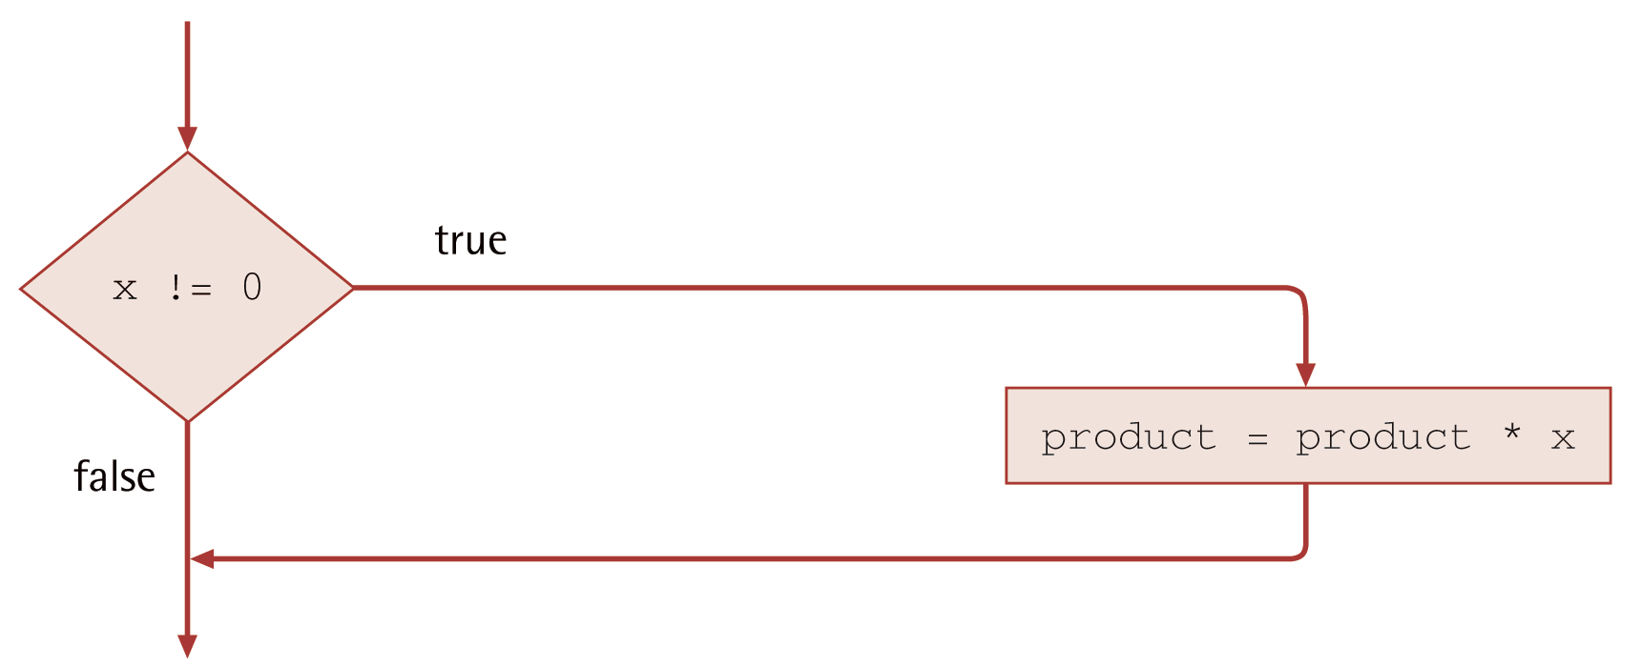
Flowchart of if Statement with Dependent Statement

Slide 25
if Statements with Compound Alternatives
To execute more than one statement in a certain case, you can specify a group of statements enclosed in {}
Any statement type (assignment, executable, function call) can be placed within the braces
Example:
if (popToday > popYesterday)
{
growth = popToday - popYesterday;
growthPct = 100.0 * growth / popYesterday;
cout << "The growth percentage is " << growthPct;
}

Slide 26
Example: if Statements with Compound Alternatives
if (transactionType == 'c’) {
// process check
cout << "Check for $" << transactionAmount << endl;
balance = balance - transactionAmount;
}
else {
// process deposit
cout << "Deposit of $" << transactionAmount << endl;
balance = balance + transactionAmount;
}

Slide 27
Program Style
The placement of the {} braces is a stylistic preference – you might want to put them on separate lines or have the opening brace on the same line as the condition
Simple rules to follow:
  Use consistent placement in all your code
  A good idea to use braces always, to make sure all if statements look similar and there is no danger of forgetting braces where needed

Slide 28
Nested if Statements and Multiple-Alternative Decisions
It is possible to use one if statement inside another
That way we can implement code decisions with more than two alternatives:
  if (x > 0)
  cout << "Positive";
  else
  if (x < 0)
  cout << "Negative";
  else
  cout << "Zero";

Slide 29
A Sequence of if Statements
Not always possible and definitely not efficient
if (x > 0)
cout << "Positive";
if (x < 0)
cout << "Negative";
if (x == 0)
cout << "Zero";

Slide 30
Multiple-Alternative Decision Example 1
if (x > 0) {
cout << "Positive";
}
else if (x < 0) {
cout << "Negative";
}
else {
cout << "Zero";
}

Slide 31
Writing a Nested if as a Multiple-Alternative Decision
Nested if statements can become quite complex.
If there are more than two alternatives and indentation is not consistent, it may be difficult to determine the logical structure of the if statement.

Slide 32
Multiple-Alternative Decision Form
    if (condition₁)
    statement₁;
    else if (condition₂)
    statement₂;
    ...
    else if (condition_{n})
    statement_{n};
    else
    statement_{e};

Slide 33
Multiple-Alternative Decision Example 2
if (score >= 90)
cout << "Grade is A " << endl;
else if (score >= 80)
cout << "Grade is B " << endl;
else if (score >= 70)
cout << "Grade is C " << endl;
else if (score >= 60)
cout << "Grade is D " << endl;
else
cout << "Grade is F " << endl;

Slide 34
Warning: Order of Conditions Matters
if (score >= 60) // NOTE: true for all good grades – A, B, etc
cout << "Grade is D " << endl;
else if (score >= 70)
cout << "Grade is C " << endl;
else if (score >= 80)
cout << "Grade is B " << endl;
else if (score >= 90)
cout << "Grade is A " << endl;
else
cout << "Grade is F " << endl;

Slide 35
Short Circuit Evaluation
Evaluation of a logical expression stops as soon as its value can be determined
  (single == 'y' && gender == 'm' && age >= 18)
    If single != 'y', gender and age are not evaluated
  (single == 'y' || gender == 'm' || age >= 18)
    If single is 'y', gender and age are not evaluated

Slide 36
Short Circuit Evaluation (continued)
Evaluation of a logical expression stops as soon as its value can be determined
  (x != 0 && y / x > 2)
    If x == 0, then y / x will not be evaluated
  (y / x > 2 && x != 0)
    If x == 0, you will see run-time error division by zero

Slide 37
What will the result from the code?
bool test = false;
if (test = true){
  cout << “Test is true”;
}
Test is true

Slide 38
What will the result from the code?
bool test = false;
if (test == true)
  cout << “Test is true”;
  cout << “Some message”;
  cout << “After the if”;
  Some message
  After the if

Slide 39
The switch Control Statement
To select one of several alternatives, C++ also provides the switch statement
Most useful when the selection is based on the value of a single variable, called the switch selector
The value of the switch selector expression must be of type int, char or bool, but not float or string.

Slide 40
General Form of the switch Statement
  switch (selector-expression)
  {
  case label1:
  statements1;
  break;
  case label2:
  statements2;
  break;
  ...
  case labelN:
  statementsN;
  break;
  default: // optional
  statementsD;
  }

Slide 41
switch Statement Interpretation
The selector expression is evaluated and compared to each of the case labels, until a match is found.
Each label is a single, constant expression, different from the other labels
When a match is found, the statements following the case label are executed until a break statement is encountered
If none of the case labels match the selector, statements in the default label (if present) are executed

Slide 42
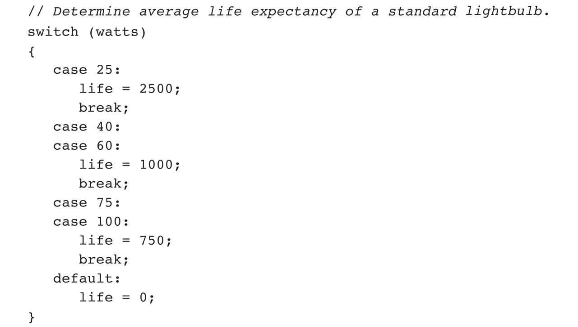
switch Statement Example

Slide 43
Questions?
Q & A

